Slide 1
Platys –Provisioning of modern data platforms simplified!
Martin Wunderli, Guido Schmutz
gschmutz
http://guidoschmutz.wordpress.com

Slide 2
Reasons for Platys
For Labs, PoC and PoV projects as well as trainings we wanted a platform
which is easy to deploy
supports modular, extensible and configurable set of services
where new services can be added quickly and tested as part of an existing platform (set of services)
where no infrastructure specialist is needed for provisioning
lightweight, low footprint (resources needed)
simple, lightweight transportation
runs on-premises and in the cloud

Slide 3

platys – Trivadis Platform in a Box
open-source toolset, developed by the Trivadis Platform Factory
Hosted on GitHub: https://github.com/TrivadisPF/platys
help provisioning Modern Data Platforms based on Docker and Docker Compose
its main use is for
small-scale Data Lab projects
Proof-of-Concepts (PoC) or Proof-of-value (PoV) projects
Trivadis Trainings (internal, external, on-site)

Slide 4
Why Docker & Docker Compose?
 |  | Bare Metal | VM | Cloud PaaS | Docker & Docker Compose
1 | Easy Deployment | + | ++ | +++ | +++
2 | Modular, extensible | ++ | ++ | ++ | +++
3 | Add new services quickly | + | + | ++ (1) | +++
4 | No infrastructre specialist needed | + | ++ | +++ | +++
5 | Lightweight footprint | + | ++ | + | +++
6 | Simple, lightweight transportation | - | + | ++ (2) | +++
7 | On prem & cloud | + | +++ | ++ | +++ (3)
If exists as PaaS
Within same cloud provider
Runs anywhere Docker & Docker Compose runs
Notes:
which is easy to deploy
Supports modular, extensible and configurable set of services
Quickly add new services and test them as part of an existing platform (set of services)
no infrastructure specialist needed for provisioning
lightweight, low footprint (resources needed)
Simple, lightweight transportation
runs on-premises and in the cloud

Slide 5
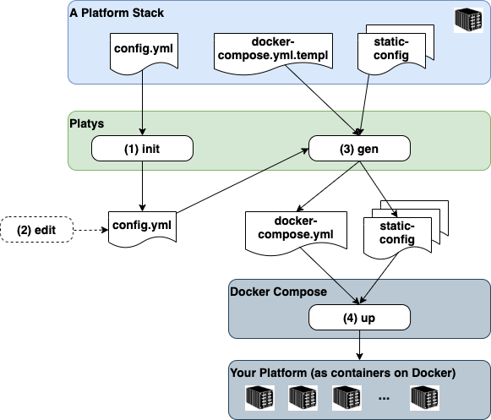
Trivadis platys – Platform in a Box
Platform Stack
A given set of services to choose from
A generator for generating a set of these services as a Platform
Platform
An instance of a set of services generated based on a Platform Stack
Fully runnable platform based on Docker Compose and Docker
Platys
The CLI tool to control the Platform Stack

Slide 6
Where to use Platys? How to “sell” it?
One-Time
Consultancy
Technology
Training
2 – 5 days
Workshop
Proof-of-Concept (PoC)
Project
platys
platys
platys
platys
use
use
use
use
Example
Thyssenkrupp
Transnet
EZD
Sales
High-end consulting rate
Example
BFH & HSLU
Trivaids Training
On-site Training
Internal Workshops
Sakes
training rate
Example
ATR
Internal Labs
Sales
Normal, training rate
Example
Sick
Printus
Sales
Budget EUR 100’000 (Printus)

Slide 7
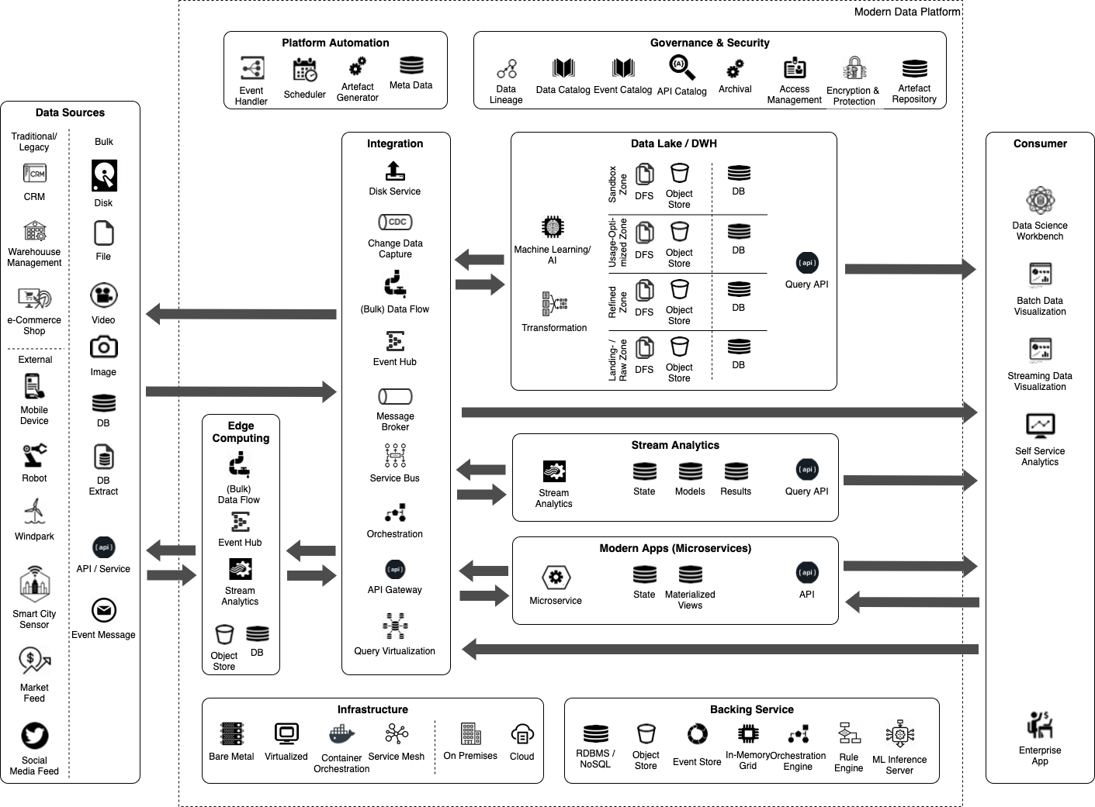
Trivadis Modern Data Platform

Slide 8
Platys support in Trivadis Modern Data Platform
Airflow
Hive
Metastore
Atlas
Amundsen
Ranger
SchemaRegistry
Marquez
Datahub
Vault
Oracle DB
Postgresql
FTP
Neo4J
MySQL
Zeppelin
Solr
Jupyter
Telegraf
Presto
Streamsets
Spark
Dremio
Superset
NiFi
KafkaConnect
Ceph
Drill
Grafana
Kafka
Minio
Kibana
ActiveMQ
HDFS
Chronograf
Streamsets
Edge
Kapacitor
Cassandra
InfluxDB
MQTT
Elasticsearch
KafkaRest
MongoDB
Livy
Portainer

Slide 9
Demo - Trivadis platys in Action
Steps for working with platys
Init a platform based on a given platform stack
Edit the config.yml files to enable services needed
Generate the docker-compose platform
Start the platform

